Slide 1

Meon
Glory awaits you.
Ana Rita Lamelas
João Fonseca

Slide 2
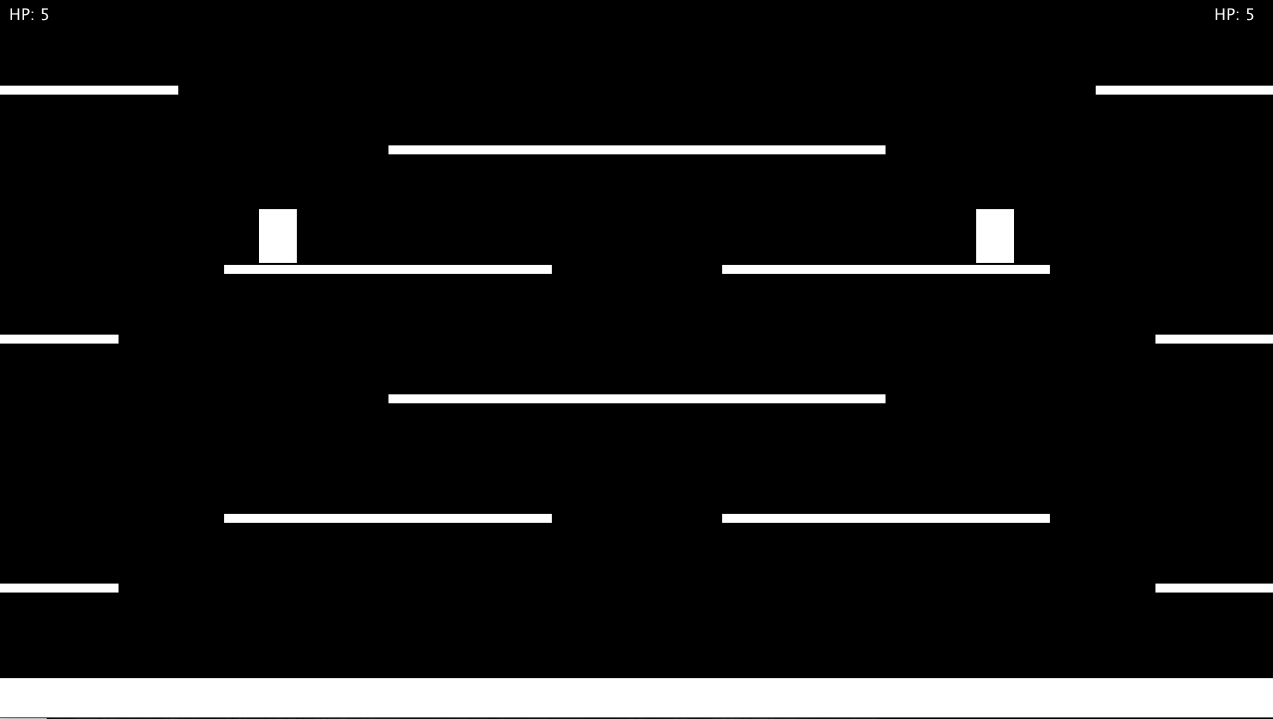
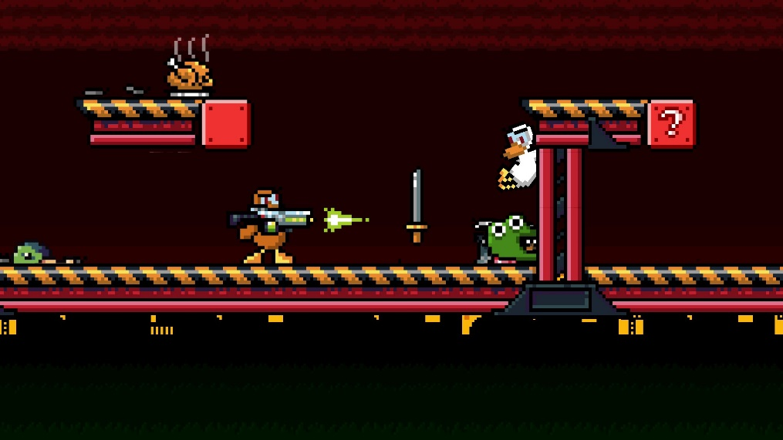
Meon - Features
1 vs 1;
2D side view;
Pixelated art;
Controller support;
Fast-paced and action-packed.
Duck Game by Landon Podbielski

Slide 3
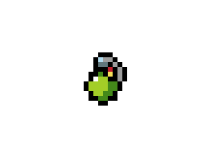
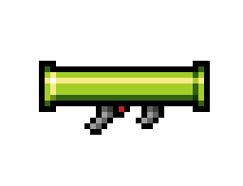
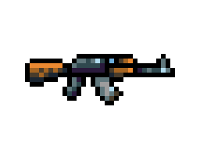

Meon - Features
Several weapons at your disposal.
Very low ammunition on each weapon, grab all you can.

Slide 4


Meon - Features
Power-ups such as more health, armor and increased damage.

Slide 5
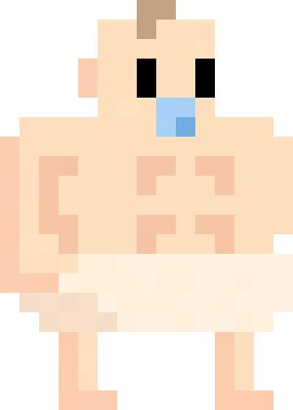
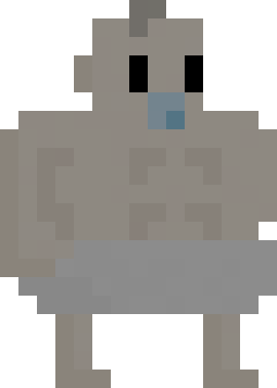

Meon – Playable Characters
dad?

Slide 6
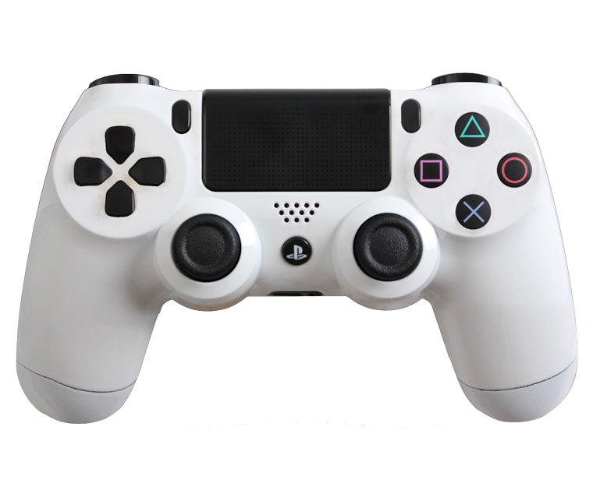
Meon - Controls
Use weapons;
Pick-up weapons;
Punch;
Jump;
Move.

